Slide 1
Project one
SAMPLING TECHNIQUES IN ACTIVE LEARNING
Selected Topics in AI-2

Slide 2
INTRODUCTION
Active Learning involves selecting the most informative data points for labeling, iteratively improving a model's performance. It differs from traditional methods by allowing the model to choose which data points to learn from, optimizing learning efficiency.

Slide 3
DATASETS EXPERIMENTED
Here is a brief of the dataset used for the experiment

Slide 4
DIGITS DATASET
IRIS DATASET
BREAST CANCER DATASET
02 - WEBSITE
DIGITS DATASET CONTAINS IMAGES OF HANDWRITTEN DIGITS FROM 0 TO 9. USED FOR MACHINE LEARNING TASKS LIKE CLASSIFICATION, WHERE THE GOAL IS TO IDENTIFY THE DIGIT IN EACH IMAGE ACCURATELY.
THE IRIS DATASET COMPRISES MEASUREMENTS OF SEPAL AND PETAL LENGTHS AND WIDTHS FOR IRIS FLOWERS, CATEGORIZING THEM INTO THREE SPECIES: SETOSA, VERSICOLOR, AND VIRGINICA. THE DATASET AIMS TO DEVELOP MODELS FOR CLASSIFYING IRIS FLOWERS INTO THESE SPECIES BASED ON THEIR MEASUREMENTS.
THE BREAST CANCER WISCONSIN DATASET PROVIDES DATA ON BREAST CANCER TUMORS TO AID IN DIAGNOSIS, DISTINGUISHING BETWEEN MALIGNANT AND BENIGN TUMORS. IT COMPRISES 569 INSTANCES, EACH WITH 30 NUMERIC FEATURES DERIVED FROM CELL NUCLEI IMAGES, INCLUDING RADIUS, TEXTURE, PERIMETER, AND AREA.

Slide 5
DIGITS DATASET
The Stroke Dataset comprises medical records of individuals, including demographics, habits, and clinical details, to investigate stroke occurrences.
Attributes such as age, gender, hypertension, and smoking status are recorded.
This dataset aids in analyzing risk factors and developing predictive models for stroke occurrence, contributing to preventive healthcare strategies.

Slide 6
OVERVIEW OF THE SAMPLING TECHNIQUES USED
This method seeks opinions from a committee of models or experts to identify informative data points, focusing on instances with the most disagreement to enhance model performance.
QUERY BY COMMITTEE (QBC)
Entropy sampling selects instances where the model is unsure about their label, aiming to reduce uncertainty and enhance performance. It targets cases with low prediction confidence to prioritize ambiguity.
ENTROPY
SAMPLING
Margin sampling selects data points near the classification model's decision boundary, challenging to classify accurately due to uncertainty. It aims to enhance model performance by addressing classification weaknesses.
MARGIN SAMPLING

Slide 7
RESULTS
Results on different balanced and imbalanced datasets using the active learning techniques

Slide 8
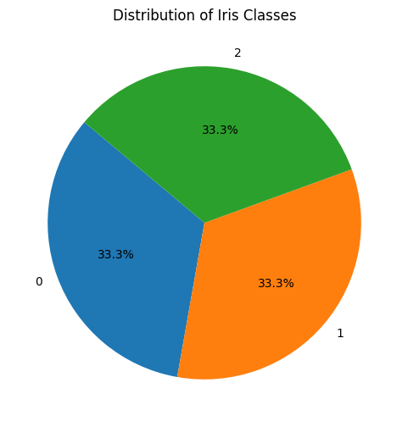
IRIS DATASET Distribution
The IRIS dataset is well-balanced, featuring an equal distribution of samples across its three species: setosa, versicolor, and virginica, making it suitable for training classification models.

Slide 9
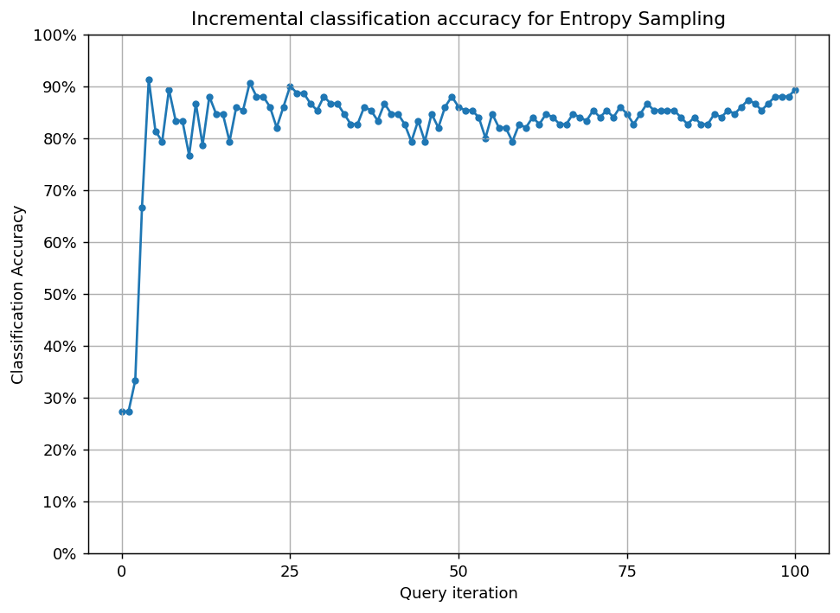
APPLYING ACTIVE LEARNING ON IRIS DATASET
ENTROPY
we utilised a pool-based sampling technique for training and applied the ParzenWindowClassifier
for making predictions. The model attained an accuracy of 0.27 without active learning. Here are the outcomes following its implementation.
accuracy score is 0.89

Slide 10
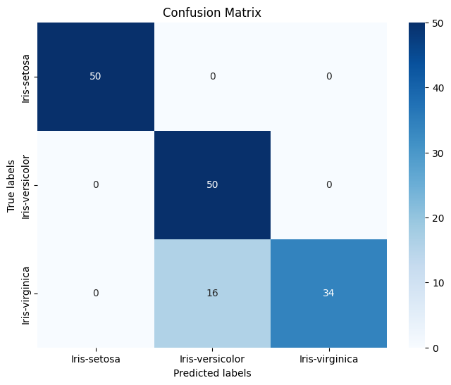
APPLYING ACTIVE LEARNING ON IRIS DATASET
ENTROPY
accuracy score is 0.89

Slide 11
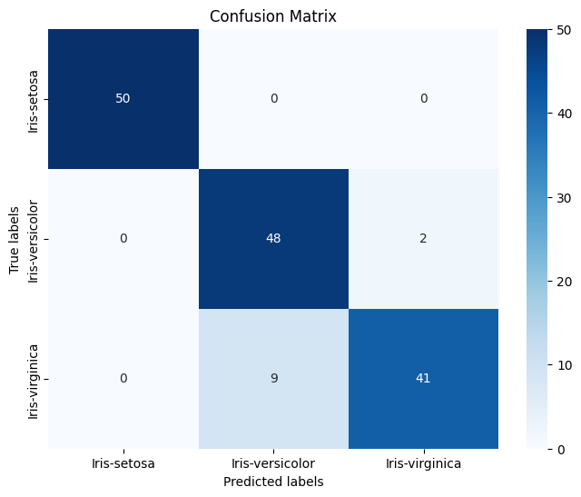
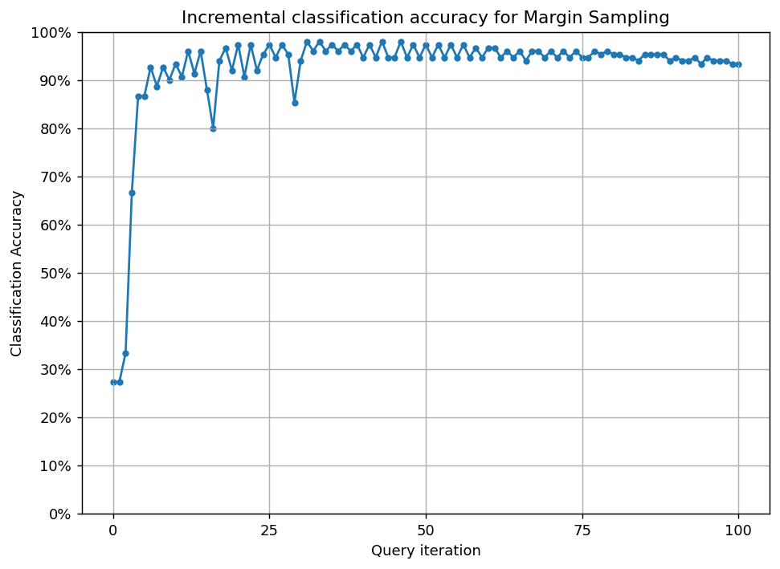
APPLYING ACTIVE LEARNING ON IRIS DATASET
MARGIN STRATEGY
accuracy score is 0.93

Slide 12
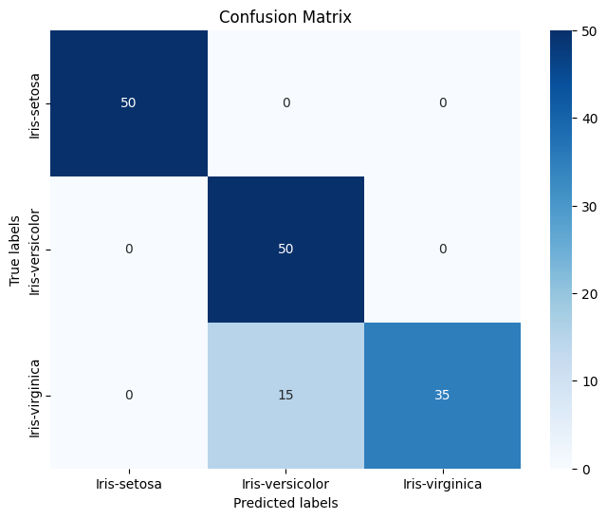
APPLYING ACTIVE LEARNING ON IRIS DATASET
QUERY BY COMMITTEE
QUERY BY COMMITTEE
accuracy score is 0.9

Slide 13
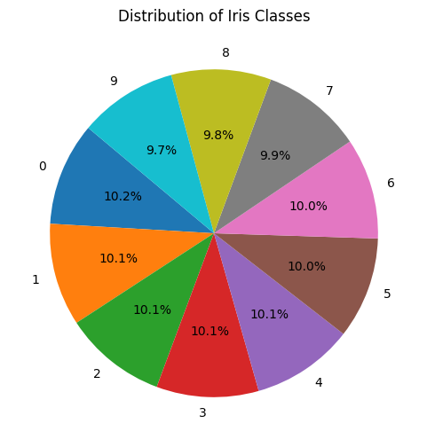
DIGITS DATASET Distribution
The Digits dataset is reasonably balanced, with an equal distribution of handwritten digits 0 through 9. This balance ensures fair representation of each digit class, facilitating effective training and evaluation of classification models.

Slide 14
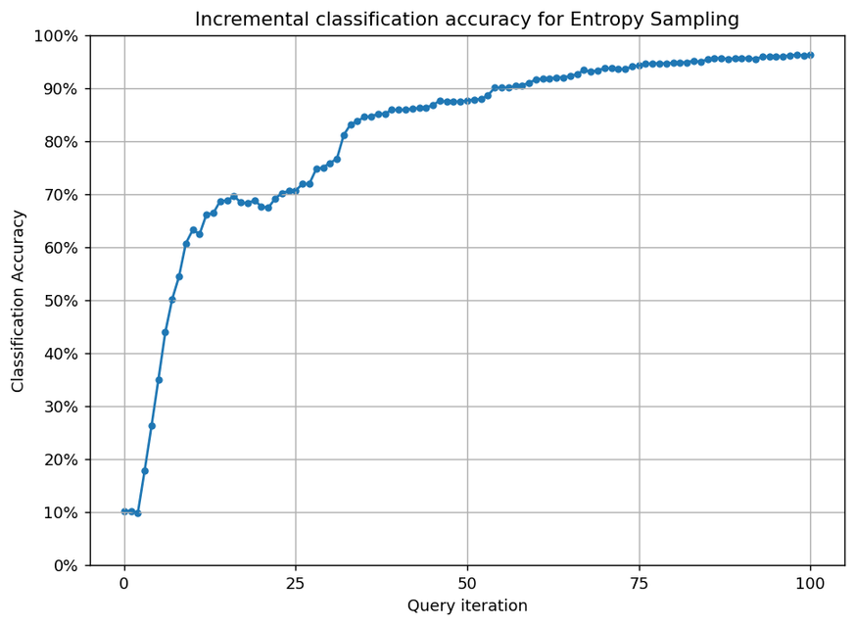
APPLYING ACTIVE LEARNING ON DIGITS DATASET
ENTROPY
Afterward, we utilised a pool-based sampling technique for training and applied the ParzenWindowClassifier for making predictions. The model attained an accuracy of 0.10 without active learning. Here are the outcomes following its implementation.
accuracy score is 0.96

Slide 15
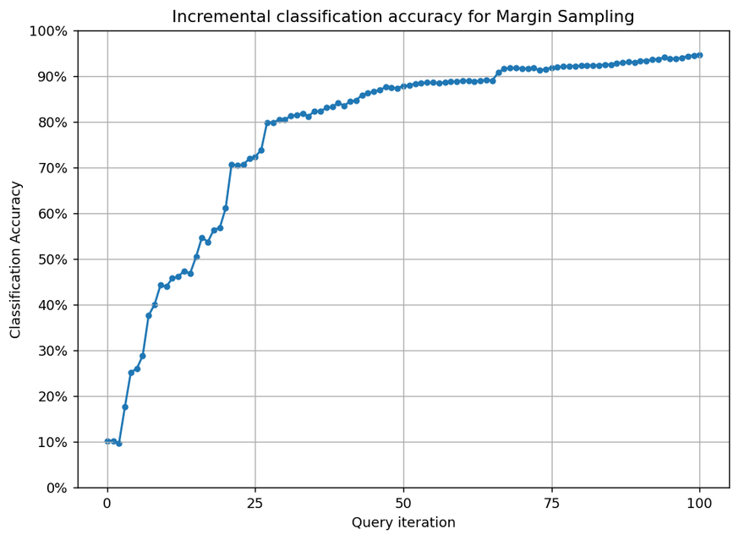
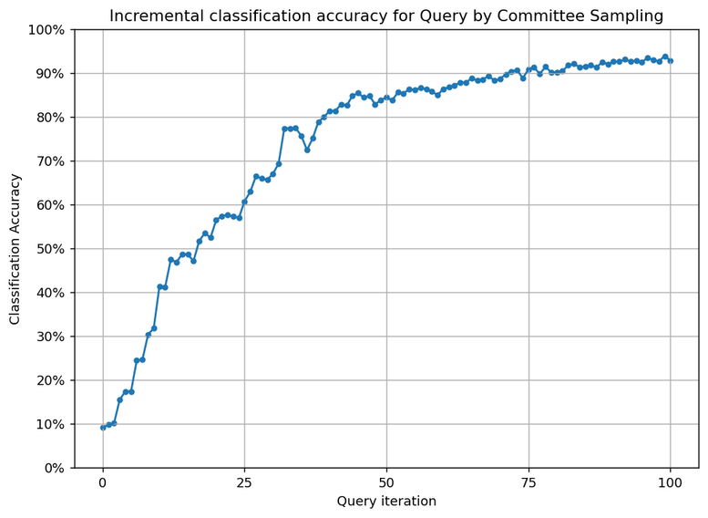
MARGIN STRATEGY
QUERY BY COMMITTEE
accuracy score is 0.94
accuracy score is 0.92

Slide 16
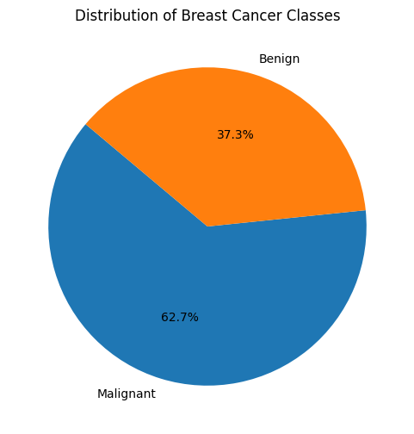
BREAST CANCER WISCONSIN DATASET
The Breast Cancer Wisconsin dataset exhibits an imbalance between the number of instances for malignant (cancerous) and benign (non-cancerous) tumors. Typically, malignant cases are fewer compared to benign cases, resulting in an imbalanced distribution.

Slide 17
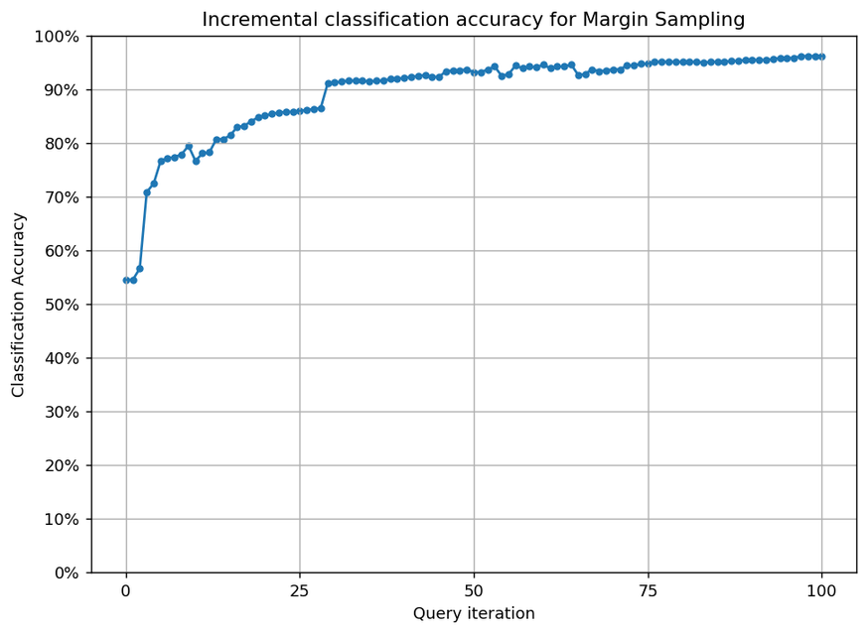
APPLYING ACTIVE LEARNING ON BREAST CANCER WISCONSIN DATASET
MARGIN SAMPLING
We utilised a pool-based sampling technique for training and applied the ParzenWindowClassifier for making predictions. The model attained an accuracy of 0.54 without active learning. Here are the outcomes following its implementation.
accuracy score is 0.96

Slide 18
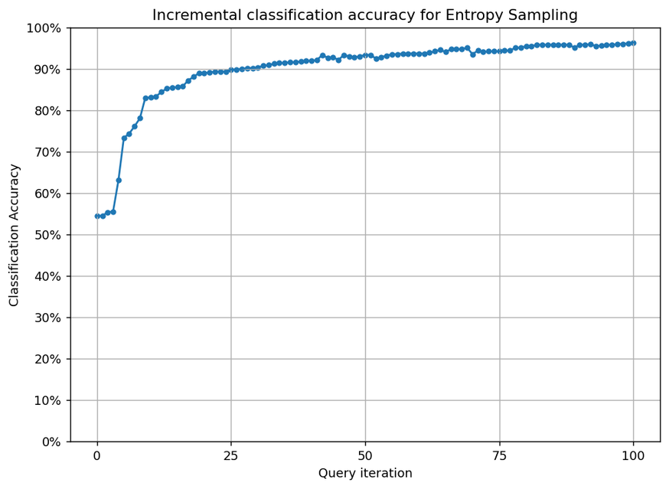
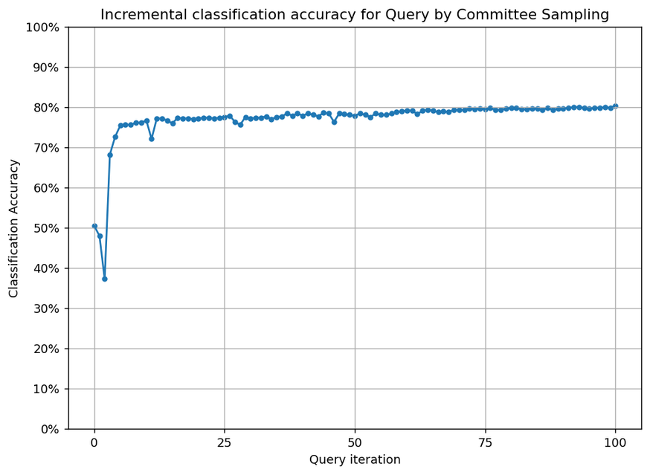
ENTROPY STRATEGY
QUERY BY COMMITTEE
accuracy score is 0.96
accuracy score is 0.80

Slide 19
APPLYING ACTIVE LEARNING ON BREAST CANCER WISCONSIN DATASET
MARGIN SAMPLING
We utilised a pool-based sampling technique for training and applied the ParzenWindowClassifier for making predictions. The model attained an accuracy of 0.54 without active learning. Here are the outcomes following its implementation.
accuracy score is 0.96

Slide 20
APPLYING ACTIVE LEARNING ON IRIS DATASET
ENTROPY
accuracy score is 0.89

Slide 21
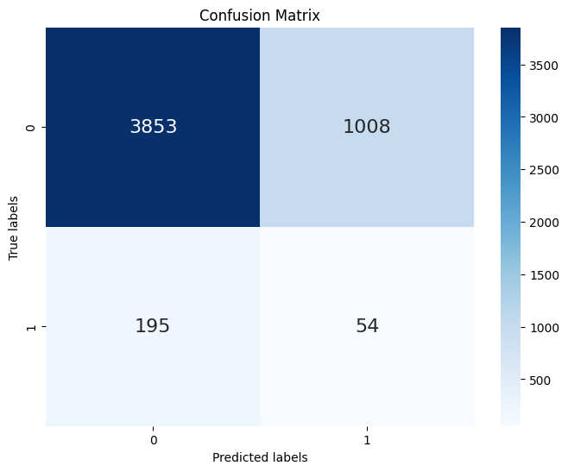
APPLYING ACTIVE LEARNING ON IRIS DATASET
ENTROPY
accuracy score is 0.89

Slide 22
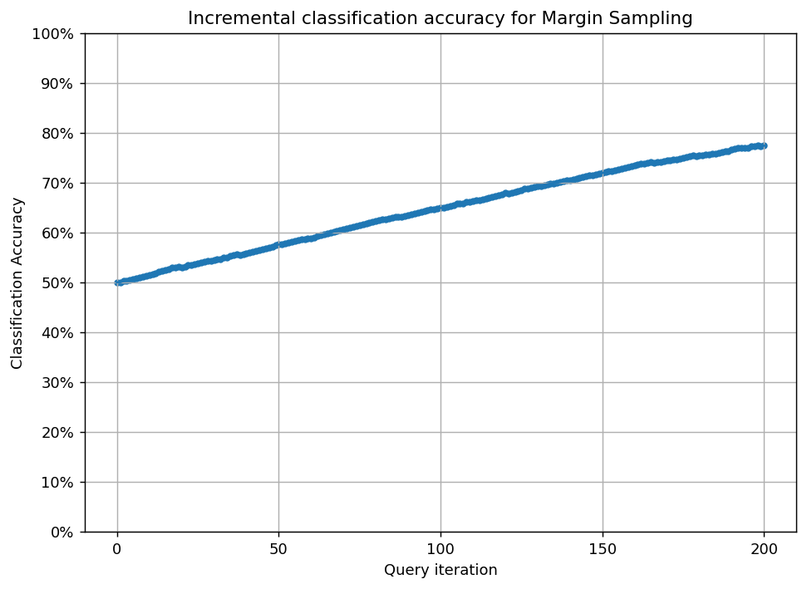

APPLYING ACTIVE LEARNING ON IRIS DATASET
MARGIN STRATEGY
accuracy score is 0.93

Slide 23
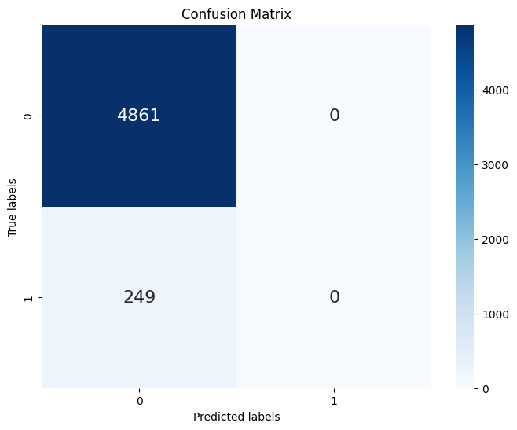
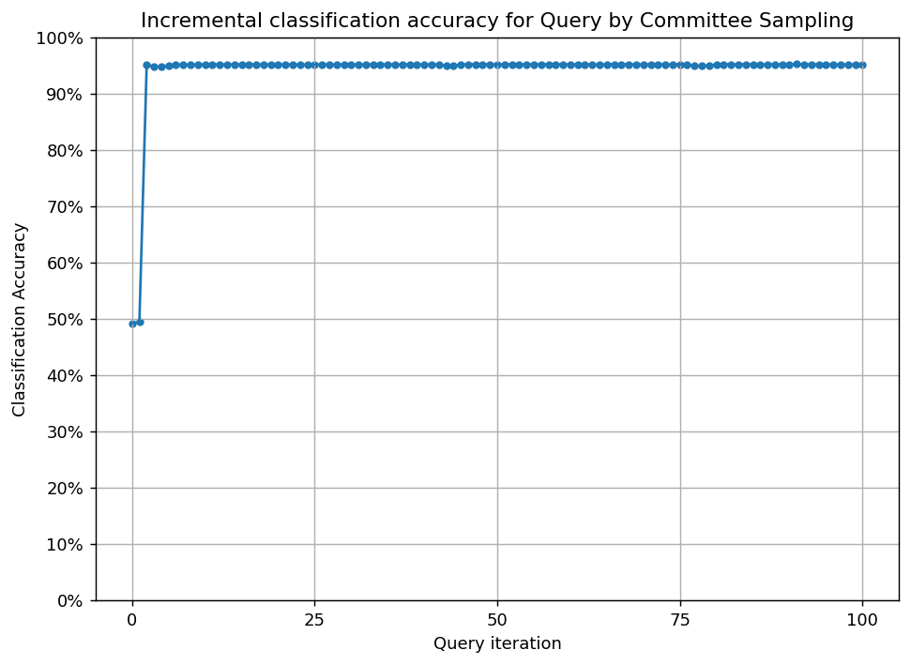
APPLYING ACTIVE LEARNING ON IRIS DATASET
QUERY BY COMMITTEE

Slide 24
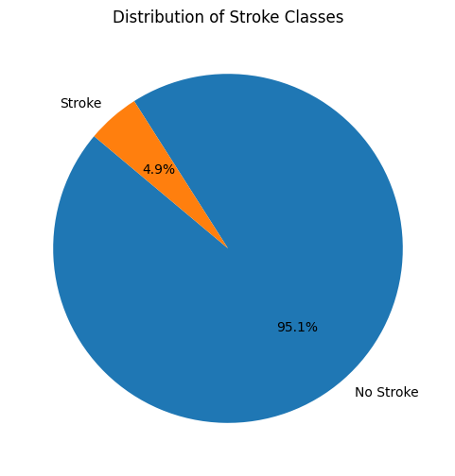
STROKE DATASET (IMBALANCED BONUS)
The Stroke Dataset contains medical records capturing demographics, habits, and clinical details to study stroke occurrences, aiding in risk analysis and predictive modeling for preventive healthcare strategies.

Slide 25

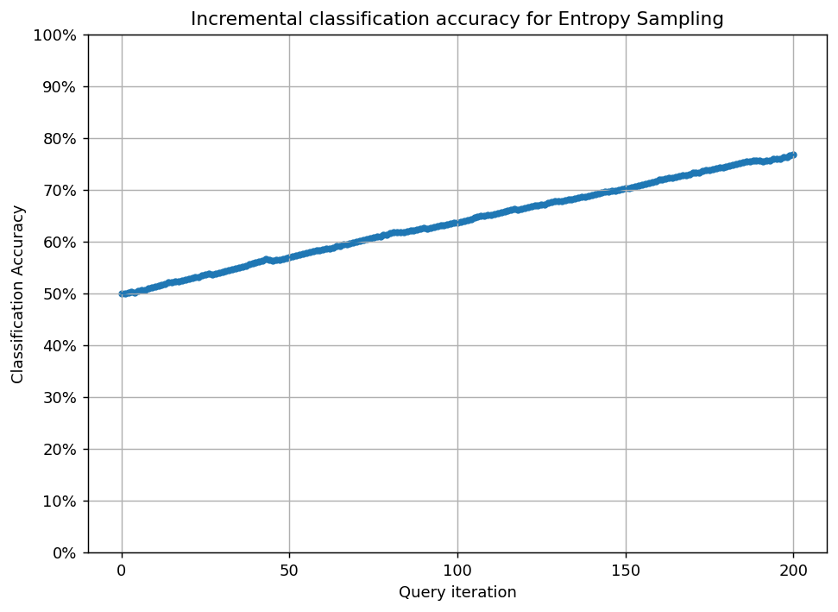
ENTROPY

Slide 26


MARGIN SAMPLING

Slide 27


QUERY BY COMMITTEE

Slide 28
CONCLUSION
1- The findings indicate that among uncertainty-based strategies, there's no significant discrepancy.
3- Furthermore, they excel in minimizing computational expenses, annotation efforts, and budgetary needs.
2-Active learning methods generally outperform others in maintaining high evaluation metric scores, notably accuracy.

Slide 29
REFERENCES
https://scikit-activeml.github.io/scikit-activeml-docs/
https:/medium.com/@hardik.dave/active-learning-sampling-strategies-f8d8ac7037c8
https:/younsess-elbrag.medium.com/active-learning-approaches-strategies-deep-learning-integration-and-essential-tools-6ff2bdfe5cb

Slide 30
Thank You
Feel free to ask any question

